Slide 1

Predictive HR Analytics for Employee Retention in the Automotive Industry
NAVIGATING THE WAR FOR TALENT
BC2407 S06 Team 2
Ang Wei Hao (U2210361E)
Aung Kaung Kaung (U2221195J)
Cindrea D’cruz (U2210122K)
Liu Yu-hsing (U2221170C)
Sarkar Mufaddal Adnan (U2210740F)
Yong Shao En Ernest (U2221153B)

Slide 2


01
Problem Statement
02
Motivation
03
EDA
04
Table of Contents
Machine Learning Models
05
Business Insights
06
Solution 1
07
Solution 2
08
Conclusion

Slide 3


Mufaddal
01
Problem Statement
Background + Introduction
Problem
Statement
Motivation
EDA
Models
Business
Insights
Solution 1
Solution 2
Conclusion

Slide 4

Mufaddal
What is Employee Attrition?
Loss of employees in a company
Due to resignations initiated by the employee
Employees leave faster than new ones being hired
Problem
Statement
Motivation
EDA
Models
Business
Insights
Solution 1
Solution 2
Conclusion

Slide 5
Introduction
Mufaddal
50.5 million US workers quit ⇒ Cost $1 trillion
Great Resignation 2022
52% of voluntarily exiting employees said steps could have been taken to deter them from leaving
Attrition: Self-inflicted problem ⇒ Early intervention crucial
Exit Interviews (Gallup, 2019)
Problem
Statement
Motivation
EDA
Models
Business
Insights
Solution 1
Solution 2
Conclusion

Slide 6
Gaps to Existing HR Process
Mufaddal
Exit Interviews &
Employee Surveys
Strategic HR Decisions
Largely ineffective as attrition is a lagging indicator
Too late to implement retention strategies when an employee is ready to leave
Results in considerable financial losses
Made based on intuition & industry best practices rather than backed by data
Leads to implementation of strategies and policies that are counterproductive towards reducing attrition
Problem
Statement
Motivation
EDA
Models
Business
Insights
Solution 1
Solution 2
Conclusion

Slide 7
Mufaddal
02
Practical Motivation
Problem
Statement
Motivation
EDA
Models
Business
Insights
Solution 1
Solution 2
Conclusion

Slide 8
Tangible and Intangible Cost
Mufaddal
Tangible Cost 1
Tangible Cost 2
Automotive Industry
Attrition rate = 46%
Median employee tenure = 3.1 years
70% of Tesla’s workforce was replaced in 2018
Cost of replacing an employee = Half to 2 times the employee's annual salary
With a headcount of 140,000, total cost of attrition is $2.45 to $9.8 billion/year
Intangible Cost 1
Intangible Cost 2
Reduced morale and poor reputation
Affects customer loyalty and productivity
Inconsistent customer experience
Erodes trust in the organisation
Problem
Statement
Motivation
EDA
Models
Business
Insights
Solution 1
Solution 2
Conclusion

Slide 9
Nielsen’s Predictive Model
Mufaddal
1
Highlighted the importance of the first year in an employee’s tenure
2
Resulted in the successful transition of 40% of vulnerable employees to new roles, increasing retention by 48%
3
Identified that teams of 10-12 members and employees who relocated further from office had increased flight risk
4
Resulted in cost savings of $8 million to $10 million
Problem
Statement
Motivation
Motivation
EDA
Models
Business
Insights
Solution 1
Solution 2
Conclusion

Slide 10

Mufaddal
Current Challenges within Tesla
Tesla has not implemented any machine learning strategies in Human Resources
Policies such as compulsory on-site work does not match employee preferences
Need to distinguish between personal and organisational factors to identify influential variables causing attrition
Problem
Statement
Motivation
Motivation
EDA
Models
Business
Insights
Solution 1
Solution 2
Conclusion

Slide 11
Cindrea
03
Exploratory data analysis (EDA)
EDA
Problem
Statement
Motivation
EDA
Models
Business
Insights
Solution 1
Solution 2
Conclusion

Slide 12
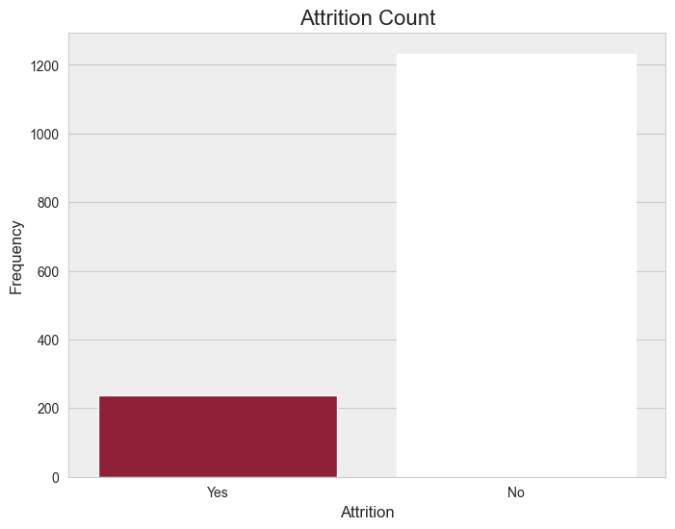
Analysing Dataset - Attrition
Cindrea
Attrition Count
83.9%
1200
1233.0
Highly imbalanced dataset, 16.1% with attrition and 83.9% without
1000
800
Expected findings as employee attrition is typically a minority case
600
400
16.1%
However, skewed dataset means predicting all “no”s would give high baseline accuracy of 83.9%
200
237.0
0
Yes
No
Additional steps must be taken to balance dataset to prevent model from over-predicting majority class
Problem
Statement
Motivation
Motivation
EDA
Models
Business
Insights
Solution 1
Solution 2
Conclusion

Slide 13
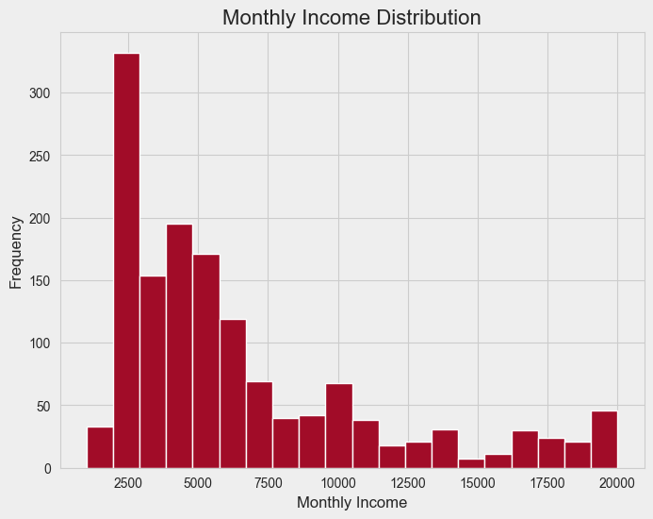
Analysing Dataset - Monthly Income
Cindrea
Monthly Income Distribution
Histogram displays a large positive skew, majority income within $2500 bracket
300
250
200
Median ($4,919) and mean ($6,503) are significantly higher than the mode
Frequency
150
100
Skew is affected by a minority group of employees who earn disproportionately more, indicating large income disparity
50
0
2500
5000
7500
10000
12500
15000
17500
20000
Monthly Income
Additional steps such as fairer compensation policies could be taken to improve employee satisfaction
Problem
Statement
Motivation
Motivation
EDA
Models
Business
Insights
Solution 1
Solution 2
Conclusion

Slide 14
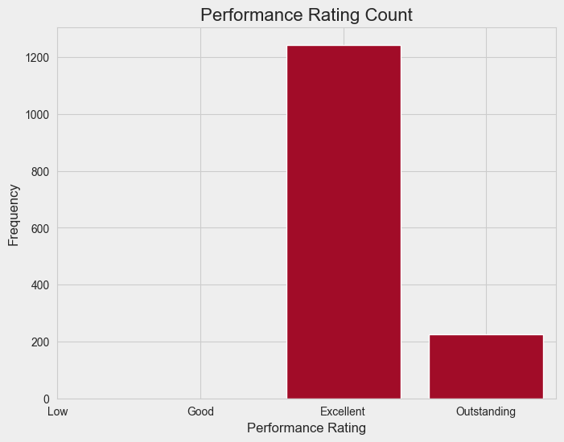
Analysing Dataset - Performance Rating
Cindrea
Performance Rating Count
Performance rating for every employee is “Excellent” or greater, indicating that every employee is motivated
1200
1000
800
However, this might suggest a lack of differentiation in the performance review process, undermining its effectiveness
Frequency
600
400
Additionally, persistent attrition rates could indicate that the issue lies in poor organisational policies rather than personal factors
200
0
Low
Good
Excellent
Outstanding
Performance Rating
Further analysis is required to determine if organisational policies or personal factors play a bigger role
Problem
Statement
Motivation
Motivation
EDA
Models
Business
Insights
Solution 1
Solution 2
Conclusion

Slide 15
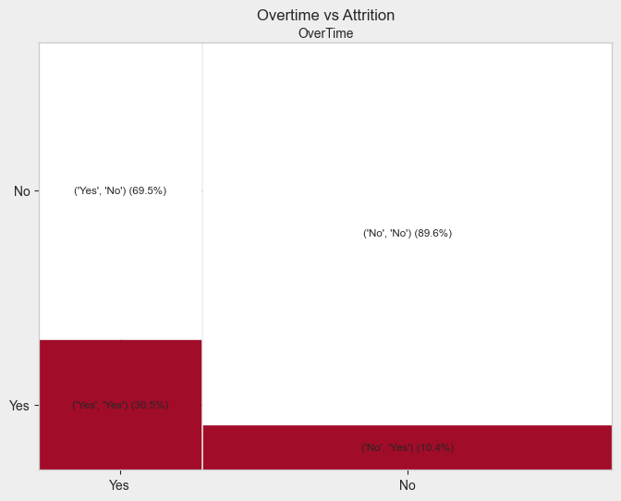
Analysing Dataset - Attrition vs Overtime
Cindrea
Attrition vs Overtime
Given that an employee works overtime, the conditional probability of the employee leaving is significantly higher (30.5%) compared to no overtime (10.4%)
No
Yes, No
(69.5%)
No, No
(89.6%)
Attrition
Employees who work overtime have significantly higher rates of attrition (30.5%) compared to the overall average attrition rate of 16.1%, while those who don't work overtime fall below the average rate (10.4%)
Yes
Yes, Yes
(30.5%)
No, Yes (10.4%)
Yes
No
Overtime
Tesla could look into policies that reduce employees’ working hours to lower its attrition rates
Problem
Statement
Motivation
Motivation
EDA
Models
Business
Insights
Solution 1
Solution 2
Conclusion

Slide 16
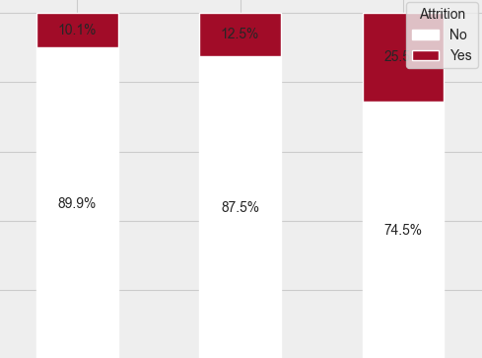
Analysing Dataset - Attrition vs Marital Status
Cindrea
Attrition Percentage by Marital Status
100
10.1%
12.5%
Single employees have higher attrition rates (25.5%) compared to their married (12.5%) and divorced (10.1%) counterparts
80
25.5%
60
Attrition Percentage
40
Single employees are twice as likely to leave the company
20
0
Divorced
Married
Single
Marital Status
Tesla could use targeted retention strategies to reduce higher attrition rates among single employees
Problem
Statement
Motivation
Motivation
EDA
Models
Business
Insights
Solution 1
Solution 2
Conclusion

Slide 17
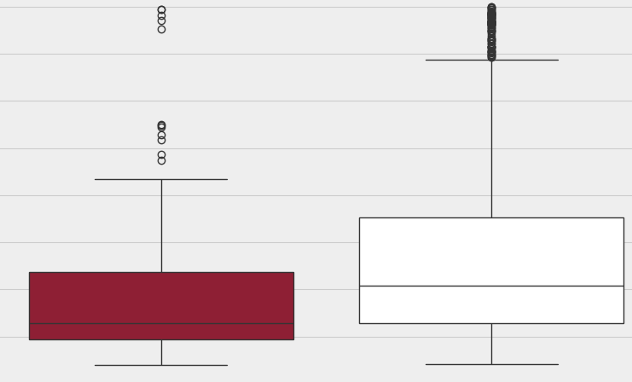
Analysing Dataset - Attrition vs Income
Cindrea
Monthly Income by Attrition
20000
Median monthly income for employees with attrition ($3,202) is significantly lower than those without ($5,204)
17500
15000
12500
Monthly Income
10000
Given most employees have monthly income between $2000 to $3000, a substantial portion of workforce falls within this salary range
7500
5000
2500
Yes
No
Attrition
Income levels could be an important factor that indicates employees’ decision to leave the company
Problem
Statement
Motivation
Motivation
EDA
Models
Business
Insights
Solution 1
Solution 2
Conclusion

Slide 18
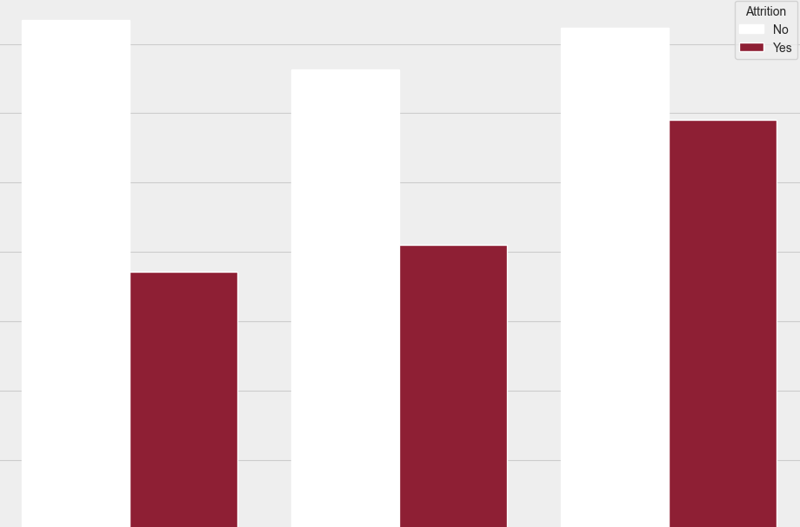
Analysing Dataset - Attrition vs Department
Cindrea
Average Income by Department and Attrition
Average monthly income is lower for employees with attrition in all 3 departments
7000
6000
5000
Despite HR and sales employees earning similar average incomes, those from sales who leave the company have significantly higher earnings, indicating that sales employees are more prone to leaving for a smaller difference in pay compared to their HR counterparts.
4000
$7345.98
Average Monthly Income
$7232.24
3000
$6630.33
$5908.46
2000
$4108.08
$3715.75
1000
0
Human Resources
Research & Development
Sales
Department
This indicates that there are more factors at play for why an employee leaves other than income
Problem
Statement
Motivation
Motivation
EDA
Models
Business
Insights
Solution 1
Solution 2
Conclusion

Slide 19
Ernest
04
Machine Learning Models
Problem
Statement
Motivation
EDA
Models
Business
Insights
Solution 1
Solution 2
Conclusion

Slide 20
Ernest
“The additional cost of engineering and maintenance does not justify the improvement in accuracy.”
- Netflix, on Pragmatic Chaos
Problem
Statement
Motivation
EDA
Models
Business
Insights
Solution 1
Solution 2
Conclusion

Slide 21
Key Business Questions
Ernest
How do I know if my model provides value?
What metrics can I use?
Why machine learning?
Problem
Statement
Motivation
EDA
Models
Business
Insights
Solution 1
Solution 2
Conclusion

Slide 22
Confusion Matrix
Ernest
Attrition ?
TN
FP
No
Actual
FN
TP
Yes
No
Yes
Predicted
Problem
Statement
Motivation
EDA
Models
Business
Insights
Solution 1
Solution 2
Conclusion

Slide 23

Ernest
Attrition: “Yes”
16.1%
Employees who leave make up the minority of cases
83.9%
Attrition: “No”
Problem
Statement
Motivation
EDA
Models
Business
Insights
Solution 1
Solution 2
Conclusion

Slide 24
Accuracy is Unreliable
Ernest
Attrition ?
80
0
No
Accuracy = 80%
Actual
Accuracy = 80%
20
0
Yes
No
Yes
Predicted
Problem
Statement
Motivation
EDA
Models
Business
Insights
Solution 1
Solution 2
Conclusion

Slide 25
Accuracy is Unreliable
Ernest
Attrition ?
80
0
No
Actual
Accuracy = 80%
Recall = 0%
20
0
Yes
No
Yes
Predicted
Problem
Statement
Motivation
EDA
Models
Business
Insights
Solution 1
Solution 2
Conclusion

Slide 26
Recall is More Suitable
Ernest
Attrition ?
70
10
No
Actual
Accuracy = 80%
Recall = 50%
10
10
Yes
No
Yes
Predicted
Problem
Statement
Motivation
EDA
Models
Business
Insights
Solution 1
Solution 2
Conclusion

Slide 27
Recall Alone is Not Enough
Ernest
Attrition ?
0
80
No
Actual
Accuracy = 20%
Recall = 100%
0
20
Yes
No
Yes
Predicted
Problem
Statement
Motivation
EDA
Models
Business
Insights
Solution 1
Solution 2
Conclusion

Slide 28
Recall Alone is Not Enough
Ernest
Attrition ?
0
80
No
Accuracy = 20%
Recall = 100%
Precision = 20%
Actual
0
20
Yes
No
Yes
Predicted
Problem
Statement
Motivation
EDA
Models
Business
Insights
Solution 1
Solution 2
Conclusion

Slide 29
Finding the Optimal Balance
Ernest
Attrition ?
60
10
No
Accuracy = ?
Recall = ?
Precision = ?
Actual
10
20
Yes
No
Yes
Predicted
Problem
Statement
Motivation
EDA
Models
Business
Insights
Solution 1
Solution 2
Conclusion

Slide 30


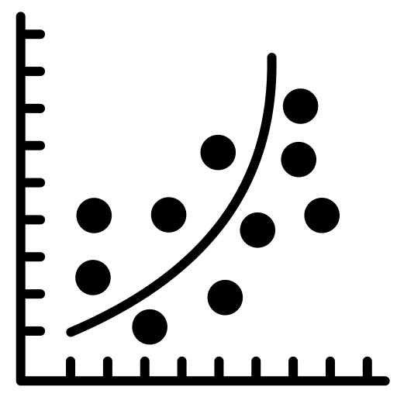


Models Used
Ernest
Logistic Regression
Neural Network
CART
Random Forest
XGBoost
Problem
Statement
Motivation
EDA
Models
Business
Insights
Solution 1
Solution 2
Conclusion

Slide 31
Models Used
Ernest
Interpret Strength of each Feature
Derive Insights from Feature Importance
Make Predictions with High Accuracy
Ensure Reliability of Features
Problem
Statement
Motivation
EDA
Models
Business
Insights
Solution 1
Solution 2
Conclusion

Slide 32
Precision-Recall Curve
Ernest
Precision: 1
Recall: 1
1.0
Precision
Area = 1.0
0
1.0
Recall
Problem
Statement
Motivation
EDA
Models
Business
Insights
Solution 1
Solution 2
Conclusion

Slide 33
Precision-Recall Curve
Ernest
Precision: 0.75
Recall: 0.5
The Optimal Tradeoff?
1.0
Precision: 0.3
Recall: 0.8
Precision
Area = 0.6
0
1.0
Recall
Problem
Statement
Motivation
EDA
Models
Business
Insights
Solution 1
Solution 2
Conclusion

Slide 34
Loss per TN = $0
Ernest
TN
FP
Savings per FN = $0
FN
TP
Problem
Statement
Motivation
EDA
Models
Business
Insights
Solution 1
Solution 2
Conclusion

Slide 35
Ernest
False Positive Prediction
True Positive Prediction
Unnecessary Expenditures from Implementing Retention Strategies
Average Cost to Retain an Employee is $5,500
Average Cost of Replacing an Employee is $62,500
52% of Employees would have Stayed with Preventive Measures
Savings = 0.52 * 62,500 = $32,500
(Tesla, 2023)
(Gallup, 2019)
(Acrisure, n.d.)
Problem
Statement
Motivation
EDA
Models
Business
Insights
Solution 1
Solution 2
Conclusion

Slide 36
Ernest
Savings per TN = $0
TN
Loss per FP = $5,500
FP
TP
________
TP + FP
Recall =
Loss per FN = $0
Savings per TP = $32,500
TP
________
TP + FP
Precision =
FN
TP
Problem
Statement
Motivation
EDA
Models
Business
Insights
Solution 1
Solution 2
Conclusion

Slide 37
Ernest
Precision: 0.75
Recall: 0.5
Savings ≈ $14,000
1.0
Precision: 0.3
Recall: 0.8
Savings ≈ $9,000
Precision
Area = 0.6
0
1.0
Recall
Problem
Statement
Motivation
EDA
Models
Business
Insights
Solution 1
Solution 2
Conclusion

Slide 38
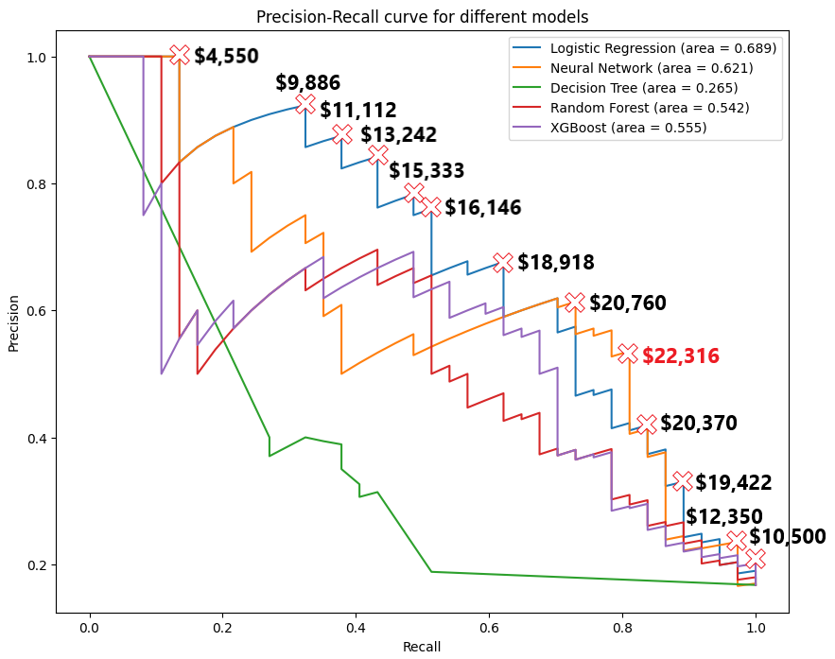
Ernest
Neural Network
Achieves the highest cost savings of $22,316 per actual attrition on average
Problem
Statement
Motivation
EDA
Models
Business
Insights
Solution 1
Solution 2
Conclusion

Slide 39
The Optimal Tradeoff
Ernest
Attrition ?
155
29
Classification Threshold = 0.395
Accuracy = 83.7%
Recall = 81.1%
Precision = 50.8%
No
7
30
Yes
No
Yes
Problem
Statement
Motivation
EDA
Models
Business
Insights
Solution 1
Solution 2
Conclusion

Slide 40
Annual Cost-Savings from Predicting Attrition
Ernest
Value | Cost Savings Per Employee | Count | Total Cost Savings
True Negative | $0 | 155 | $0
False Negative | $0 | 7 | $0
False Positive | -$5,500 | 29 | -$159,500
False Negative | $32,500 | 30 | $975,000
Total | - | 221 | $815,500
Problem
Statement
Motivation
EDA
Models
Business
Insights
Solution 1
Solution 2
Conclusion

Slide 41
Ernest
By preemptively identifying employee with high attrition risk and taking measures, Tesla can save $516 million a year
Problem
Statement
Motivation
EDA
Models
Business
Insights
Solution 1
Solution 2
Conclusion

Slide 42

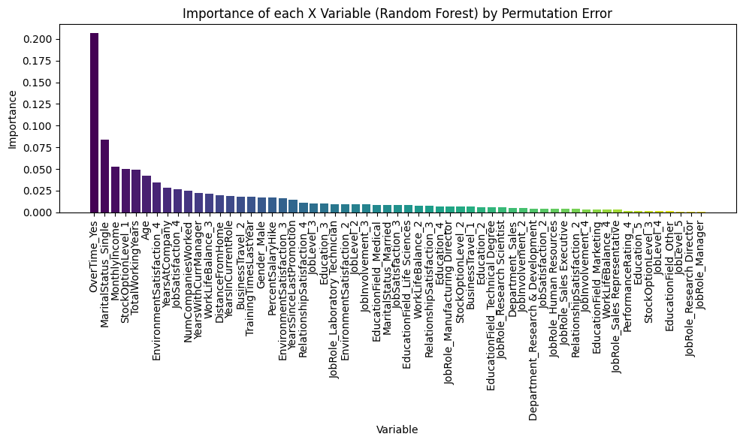
Ernest
Random Forest
Problem
Statement
Motivation
EDA
Models
Business
Insights
Solution 1
Solution 2
Conclusion

Slide 43
Variable Importance
Ernest
1
2
3
OverTime
Score: 21.2%
MaritalStatus
Score: 8.0%
StockOptionLevel
Score: 5.0%
OverTime accounts for 21.2% of the variability in predicting Attrition
Problem
Statement
Motivation
EDA
Models
Business
Insights
Solution 1
Solution 2
Conclusion

Slide 44
Ernest
Tackling overtime rates will lead to the highest decrease in the attrition rate, maximising cost-benefit
Problem
Statement
Motivation
EDA
Models
Business
Insights
Solution 1
Solution 2
Conclusion

Slide 45
Yu-Hsing
05
Business Insights
Dashboard (Power BI) + Model Deployment
Problem
Statement
Motivation
EDA
Models
Business
Insights
Solution 1
Solution 2
Conclusion

Slide 46
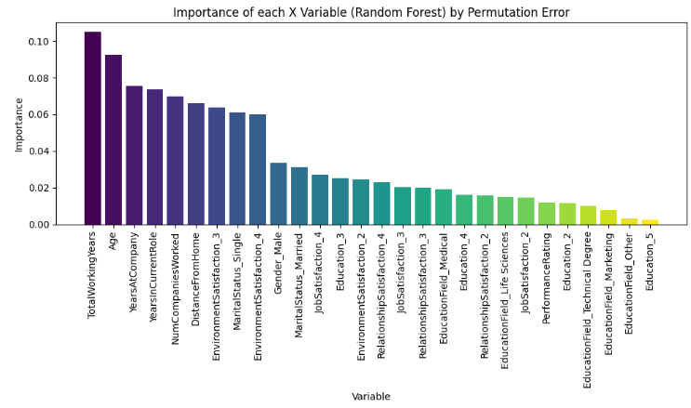
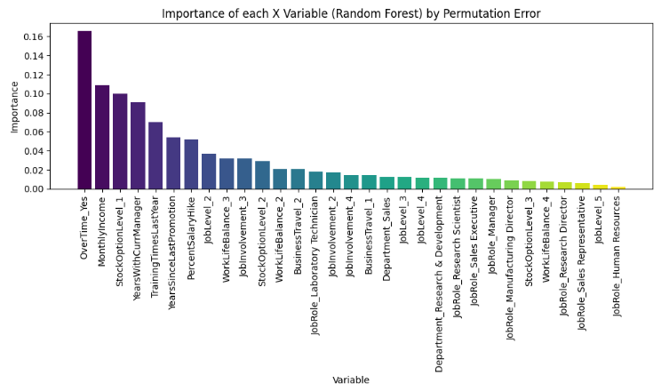
Business Insight - Variable Importance
Yu-Hsing
Organisational Factors
Personal Factors
How does each variable affects attrition rate? Increase? Decrease?
Problem
Statement
Motivation
EDA
Models
Business
Insights
Solution 1
Solution 2
Conclusion

Slide 47
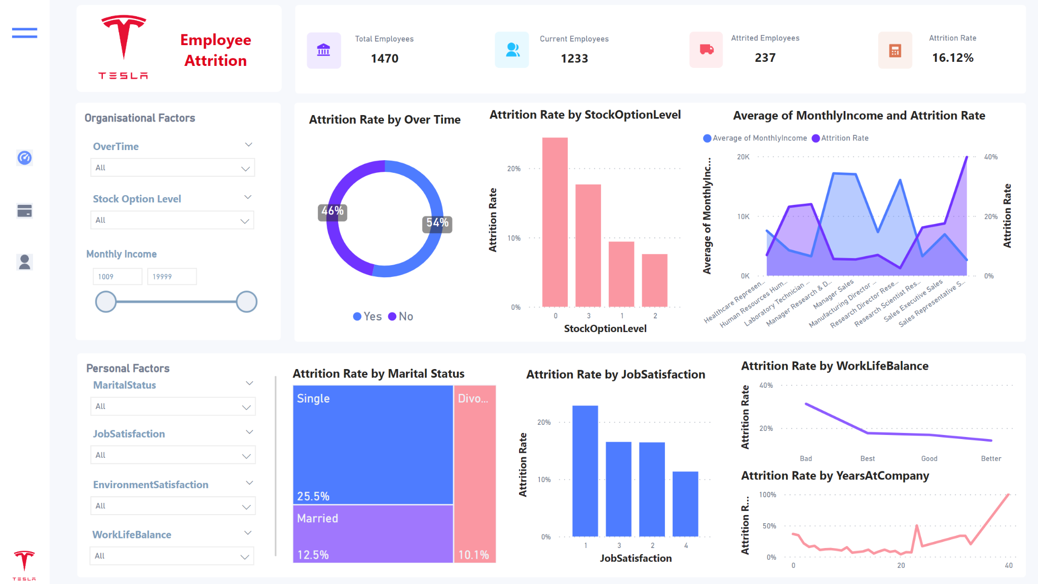
Yu-Hsing
Problem
Statement
Motivation
EDA
Models
Business
Insights
Solution 1
Solution 2
Conclusion

Slide 48
Yu-Hsing
06
Solution 1 - OverTime
Phase 1: Reducing Working Hours
Problem
Statement
Motivation
EDA
Models
Business
Insights
Solution 1
Solution 2
Conclusion

Slide 49
Overtime at Tesla - Background
Yu-Hsing
“We worked 4 days a week, but 12 hours per day”
(48hr/week)
“In times of tight deadlines, we worked 13-14 hours”
(Excessive Overtime)
[Compressed Workweek Schedule]:
2-shift System
Problem
Statement
Motivation
EDA
Models
Business
Insights
Solution 1
Solution 2
Conclusion

Slide 50

Excessive Overtime - Physical Health
Yu-Hsing
Prolonged Physical Strain
Risk to well-being
↑dissatisfaction
Higher attrition
Problem
Statement
Motivation
EDA
Models
Business
Insights
Solution 1
Solution 2
Conclusion

Slide 51
Tackle “OverTime”-- Redefine Shift System
Yu-Hsing
2-shift System
No ↓ in employees’ total working time
12 hours per day
4 days a week
With OT ≈ 13~14 hr
BUT ↓ likelihood and necessity of overtime on the same working day
3-shift System
8 hours per day
5 days a week
With OT ≈ 9~10hr
↓ extent of overtime
⇒ Even if required, total working hours per shift is not excessively long
Problem
Statement
Motivation
EDA
Models
Business
Insights
Solution 1
Solution 2
Conclusion

Slide 52

Tackle “Overtime” - Cross-Train Employees
Yu-Hsing
Equip workers with multiple skills
↑ Operational flexibility and responsiveness to workload fluctuations
Training & Development Program
Seamlessly transition between tasks
Prevents burnout and fosters a more resilient workforce
Disperses responsibility more evenly
↓ reliance on a few individuals
Mitigate excessive overtime
Problem
Statement
Motivation
EDA
Models
Business
Insights
Solution 1
Solution 2
Conclusion

Slide 53
Aung Kaung Kaung
06
Solution 1 - OverTime
Phase 2: HR Monitoring Platform
Problem
Statement
Motivation
EDA
Models
Business
Insights
Solution 1
Solution 2
Conclusion
Notes:
In phase 2 of our solution 1, we address the concern that reducing working hours might not always be feasible due to Tesla’s ambitious goal of becoming a leading player in the automotive industry through creating affordable electric vehicles.

Slide 54




Feasibility of Reducing Overtime
Aung Kaung Kaung
Tesla’s Market Position
Overtime Work Culture
Tesla has an ambitious goal of becoming the leading player in the automotive industry
Emphasis on employee presence + requirement of reporting to office ≥40h/week → inevitable pressure to work overtime
Supportive Measures
Overtime is sometimes Unavoidable
Help employees cope by identifying factors that entice them to stay despite having to work overtime
To meet Tesla’s ambitious targets, employees have to work extra hard to secure Tesla’s financial position
Problem
Statement
Motivation
EDA
Models
Business
Insights
Solution 1
Solution 2
Conclusion
Notes:
With its emphasis on employee presence and a policy requiring employees to report to offices “at least 40 hours a week”. it is inevitable that employees have to work long hours. However, measures can be taken to help employees cope with overtime hours by finding out the factors that make employees stay in spite of having to work overtime.

Slide 55
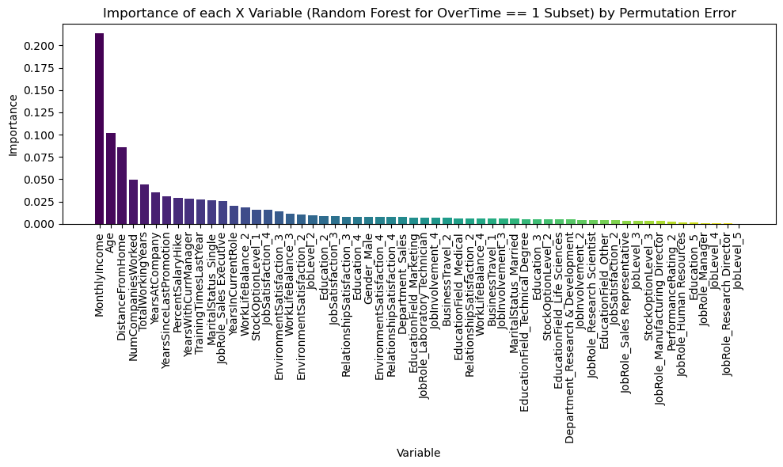
Aung Kaung Kaung
Problem
Statement
Motivation
EDA
Models
Business
Insights
Solution 1
Solution 2
Conclusion
Notes:
To delve deeper into key factors that employees working overtime might consider to be important, a secondary Random Forest model was built on a subset of the data that contains only employees working overtime. The variable importance chart from this model will help us identify significant variables that can potentially be helpful in retaining employees who need to work overtime. As seen from the chart, these variables turned out to be MonthlyIncome, Age and DistanceFromHome.

Slide 56
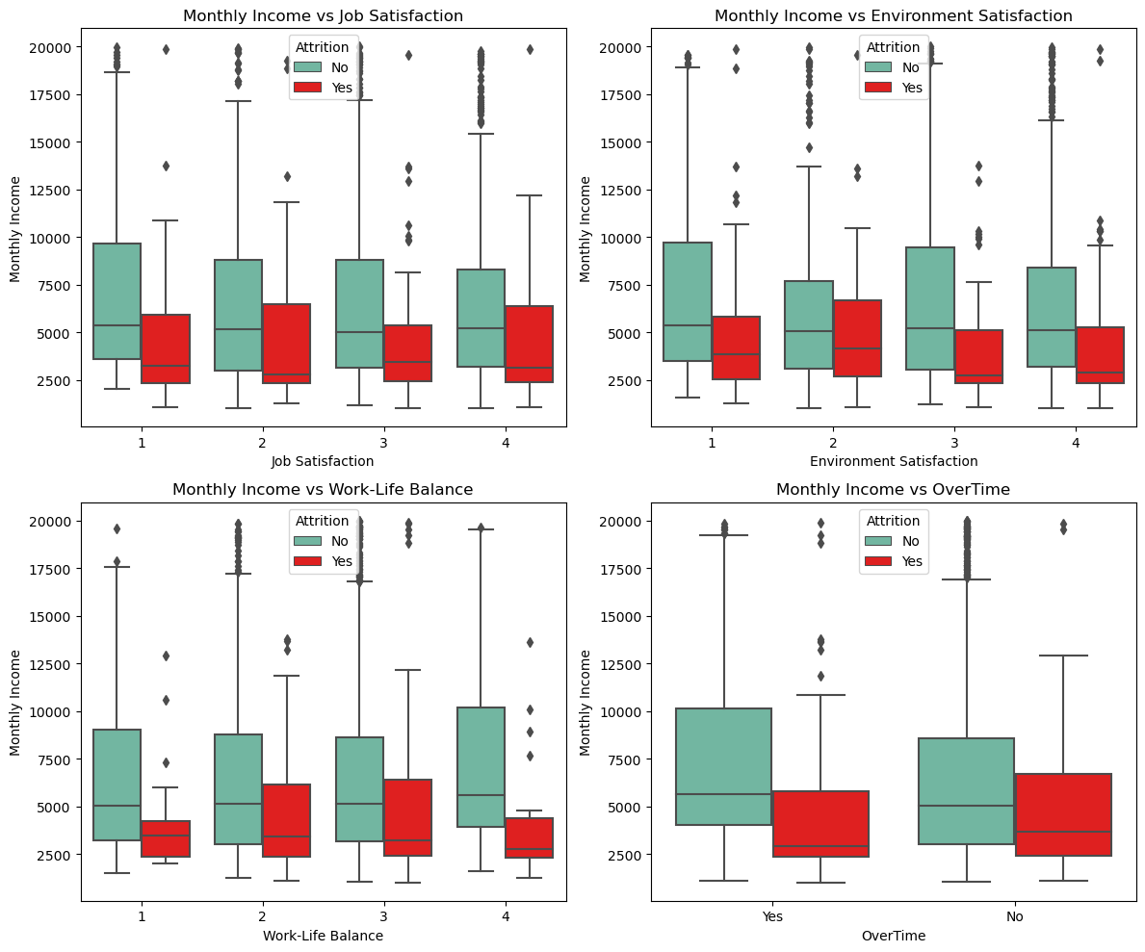
Aung Kaung Kaung
Problem
Statement
Motivation
EDA
Models
Business
Insights
Solution 1
Solution 2
Conclusion
Notes:
MonthlyIncome is the most important variable in predicting attrition among employees who work overtime. This observation is corroborated by the boxplots shown, which display how employees who leave generally have lower median income than those who chose to stay despite working overtime or reporting low satisfaction levels.

Slide 57



Higher Monthly Income → Lower Attrition Rate
Aung Kaung Kaung
Fair Compensation
More Motivation
Higher Opportunity Cost
Employees who have to work overtime would expect fair financial compensation for the extra hours they have sacrificed for the company
This will appease their dissatisfaction for having to work overtime and provide more motivation to stay
Receiving higher pay also means higher opportunity cost should the employee choose to leave, as they would have to find a job with a similar pay
Problem
Statement
Motivation
EDA
Models
Business
Insights
Solution 1
Solution 2
Conclusion
Notes:
This can be explained by how employees who have to work overtime would expect fair compensation for their extra hours and this can appease their dissatisfaction. Receiving higher pay also means higher opportunity cost for the employee should they choose to leave, as they would have to find a job with a similar level of pay. Hence, increasing monthly income can encourage employees who work overtime to stay, thereby lowering the attrition rate.

Slide 58


Distance From Home
Aung Kaung Kaung
Higher​​​​ Transportation Expenses
↑Distance → ↑Transportation costs → ↓Disposable income
For employees relying on public transport, they may have to take alternative modes of transport back home due to working late hours
Longer Travel Time
↑Time spent travelling → ↓Rest time between shifts → ↑Exhaustion
Problem
Statement
Motivation
EDA
Models
Business
Insights
Solution 1
Solution 2
Conclusion
Notes:
Notably, DistanceFromHome were found to be also crucial deciding factors for attrition among employees who work overtime. This can be explained by higher transportation expenses and longer travelling times incurred on top of working overtime, which leads to lower disposable income and shorter rest times. All these will further drive down motivation to stay in the company, increasing attrition rates among overtime employees. However, addressing personal factors like this would require changes to Tesla’s hiring strategy by ensuring that future employees are a better fit and will be less likely to leave the company. This would be elaborated in more detail in our second solution later on.

Slide 59
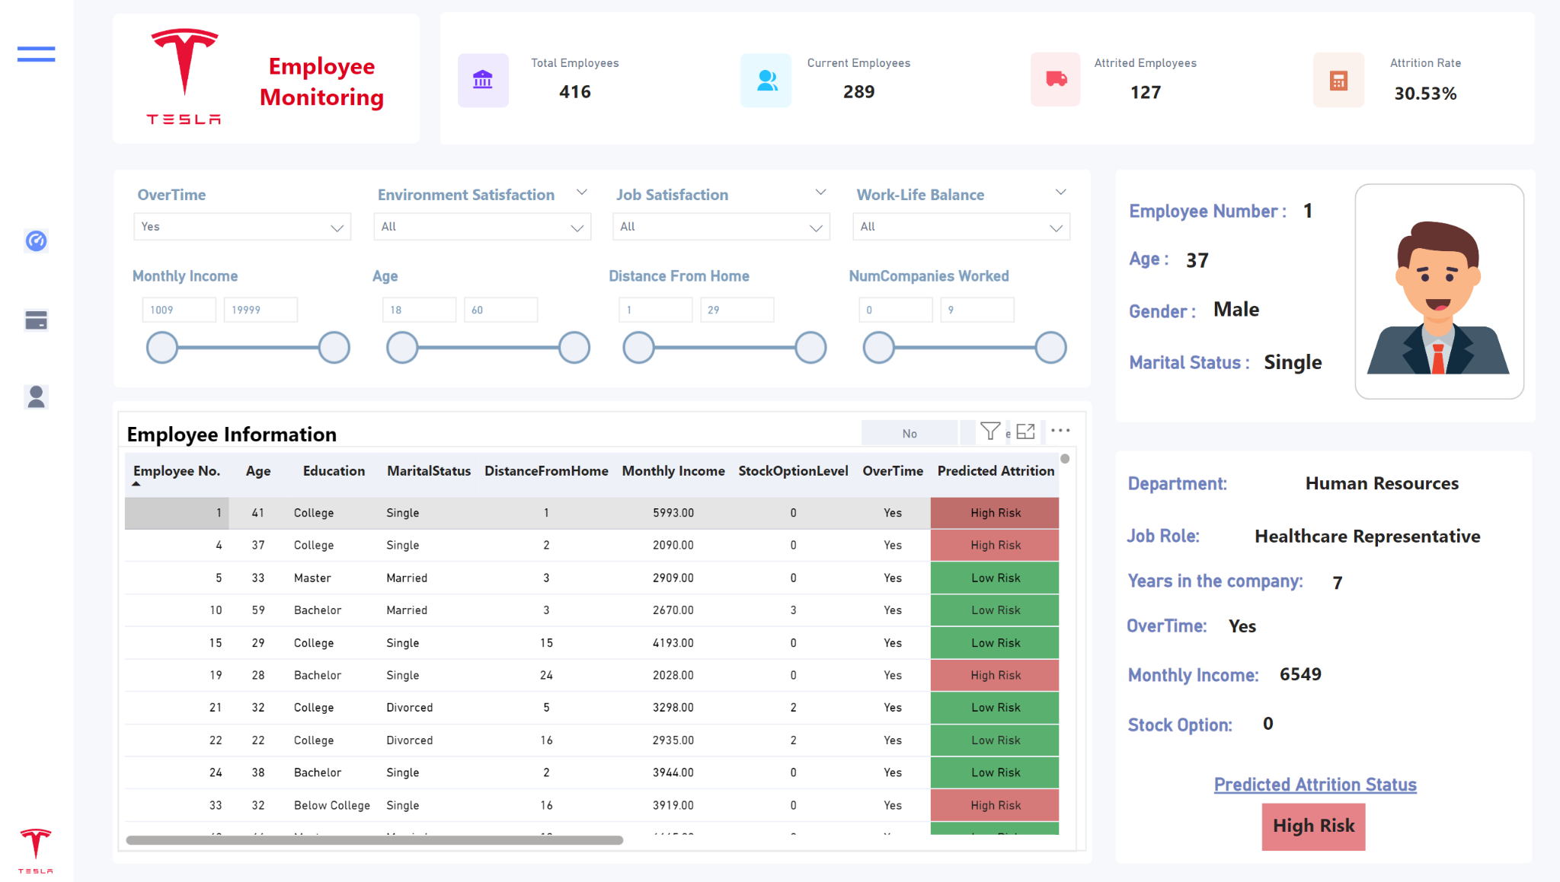
Problem
Statement
Motivation
EDA
Models
Business
Insights
Solution 1
Solution 2
Conclusion
Notes:
From these insights, we have come up with an interactive dashboard to serve as a robust HR monitoring platform. Here is a screenshot of what a prototype might look like. HR can compare attrition rates for different filters applied, with each categorical variable utilising a checkbox and each numeric variable utilising a slider.

Slide 60




Robust HR Monitoring Platform
Aung Kaung Kaung
Identify Optimal Financial Compensation to Reduce Attrition
Integrated with Our Best Model to Maximise Cost Savings
Real-Time Predictions for Preemptive Identification of High Risk Employees
Trigger Alerts To Proactively Address Employees’ Needs
Problem
Statement
Motivation
EDA
Models
Business
Insights
Solution 1
Solution 2
Conclusion
Notes:
By adjusting the values for each variable and comparing the attrition rate output by the dashboard, HR can identify the optimal financial compensation that reduces attrition rates. Additionally, the Neural Network is integrated into the dashboard to make predictions on employees in real time, allowing HR to preemptively identify employees at risk of attrition. This can be further supplemented by a feature that allows HR managers to set up customizable alerts based on specific triggers. For example, they could receive instant notifications when attrition rate in a particular department or job role or income group exceed a predefined threshold, thereby enabling them to proactively implement appropriate retention strategies to address the employees’ needs. Thus, our analytics-driven strategy directly reduces the attrition rate, fulfilling our second key business target.

Slide 61
Wei Hao
07
Solution 2
Employee Scorecard & Strategic Heat Map
Problem
Statement
Motivation
EDA
Models
Business
Insights
Solution 1
Solution 2
Conclusion

Slide 62
Variable Importance
Wei Hao
Personal Variable Importance
Organisational Variable Importance
Cultural Fit Scorecard
Organisational Alignment Scorecard
Problem
Statement
Motivation
EDA
Models
Business
Insights
Solution 1
Solution 2
Conclusion

Slide 63
Sample Cultural Fit Scorecard
Wei Hao
Variables | Weight | Scoring Criteria | Weighted Score
Total Working Years | 19% | Total working years between 20-40 receives 5 points, 11-20 receives 3 points, 0-10 receives 1 point
Age | 16% | Age between 41-60 receives 5 points, 21-40 receives 3 points, 18-20 receives 1 point
Years At Company | 12% | 21-40 years at company receives 5 points, 0-20 years at company receives 1 point
No. of Companies Worked At | 11% | Working at 5-9 companies receives 5 points, 0-4 companies receives 1 point
Distance From Home | 10% | Distance of 0-14 from home receives 5 points, 14-29 receives 1 point
Environment Satisfaction | 9% | High and Very High environment satisfaction receives 5 points, Medium receives 3 points, Low receives 1 point
Marital Status | 8% | Divorced employees receive 5 points, Married receive 3 points, Single receive 1 point
Gender | 5% | Female employees receive 5 points, Male receive 1 point
Job Satisfaction | 4% | Very high job satisfaction receives 5 points, Medium and High receive 3 points, Low receives 1 point
Education Level | 3% | Doctorate degree receives 5 points, Master degree receives 4 points, College degree receives 3 points, Bachelor degree receives 2 points, Below college education receives 1 point
Relationship Satisfaction | 2% | Medium to Very High relationship satisfaction receive 5 points, Low receives 1 point
Education Field | 1% | Medial and other education fields receive 5 points, Life sciences receives 4 points, Marketing receives 3 points, Technical receives 2 points, Human resources receives 1 point
Problem
Statement
Motivation
EDA
Models
Business
Insights
Solution 1
Solution 2
Conclusion

Slide 64


Example: Education Level
Wei Hao
Scoring Criteria
Doctorate Degree | 5 points
Master Degree | 4 points
College Degree | 3 points
Bachelor Degree | 2 points
Below College Degree | 1 point
Max Points | 5 points
Employee A: Bachelor Degree
Points Assigned: 4 points
Points
Weight
Score
⅘
3%
2.4%
Problem
Statement
Motivation
EDA
Models
Business
Insights
Solution 1
Solution 2
Conclusion

Slide 65

Cultural Fit Score
Wei Hao
Variables | Weighted Score
Total Working Years | 3.8%
Age | 9.6%
Years At Company | 2.4%
No. of Companies Worked At
. . . | . . .
Cultural Fit Score | 41.6%
↓ Cultural Fit Score
=
↑ Attrition Risk
Problem
Statement
Motivation
EDA
Models
Business
Insights
Solution 1
Solution 2
Conclusion

Slide 66
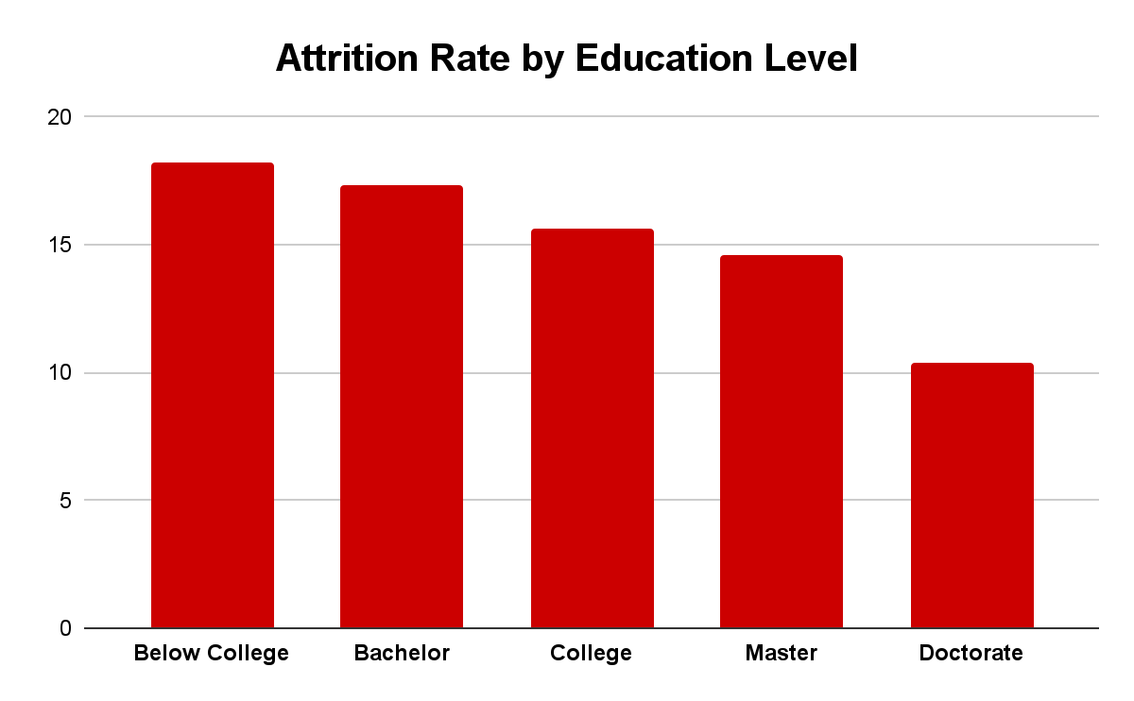
Derivation of Scoring Criteria
Wei Hao
Scoring Criteria
Doctorate Degree | 5 points
Master Degree | 4 points
College Degree | 3 points
Bachelor Degree | 2 points
Below College Degree | 1 point
Max Points | 5 points
EDA
Scorecard
Problem
Statement
Motivation
EDA
Models
Business
Insights
Solution 1
Solution 2
Conclusion

Slide 67
Derivation of Variable Weights
Wei Hao
Variables | Weight
Total Working Years | 19%
Age | 16%
Years At Company | 12%
No. of Companies Worked At | 11%
. . . | . . .
Variable Importance (Personal)
Scorecard
Problem
Statement
Motivation
EDA
Models
Business
Insights
Solution 1
Solution 2
Conclusion

Slide 68
Strategic Heat Map
Wei Hao
Monitor
Promote
Informs the development of actionable goals and plans for employee retention
Organisational Alignment
Focus
Maintain
Cultural Fit
Problem
Statement
Motivation
EDA
Models
Business
Insights
Solution 1
Solution 2
Conclusion

Slide 69
Strategic Heat Map
Wei Hao
Monitor
Promote
1.
Focus
Low cultural fit and organisational alignment
“Red flags” with highest risk of leaving Tesla
Where Tesla should focus time and resources to achieve highest business impact
Organisational Alignment
Focus
Maintain
Cultural Fit
Problem
Statement
Motivation
EDA
Models
Business
Insights
Solution 1
Solution 2
Conclusion

Slide 70
1.
Wei Hao
Focus
Strategy: Develop a Contingency Plan
Engage in discussions to identify reasons for wanting to leave Tesla
Stay Interviews
Tailored to needs and concerns of the employee
Career development opportunities
Increased recognition and rewards
Adjustments to compensation and benefits packages
Customise Retention Plans
Problem
Statement
Motivation
EDA
Models
Business
Insights
Solution 1
Solution 2
Conclusion

Slide 71
Strategic Heat Map
Wei Hao
Monitor
Promote
2.
Maintain
High cultural fit, low organisational alignment
Committed to Tesla’s values and beliefs
Further measures can be taken to ensure their continued involvement in the company’s goals and objectives
Organisational Alignment
Focus
Maintain
Cultural Fit
Problem
Statement
Motivation
EDA
Models
Business
Insights
Solution 1
Solution 2
Conclusion

Slide 72
2.
Wei Hao
Maintain
Strategy: Increase Employee Engagement
Bring employees from different departments together
Collaborate on company-wide strategic initiatives
Cross-Functional Teams
Provide a platform to give feedback
Have a greater say in Tesla’s future company plans
Pulse Surveys & Focus Groups
Performance Management
Revised to better align KPIs with company goals
Problem
Statement
Motivation
EDA
Models
Business
Insights
Solution 1
Solution 2
Conclusion

Slide 73
Strategic Heat Map
Wei Hao
3.
Monitor
Monitor
Promote
Low cultural fit, high organisational alignment
Most of these individuals would have been identified and rejected during hiring stage
Some might slip through undetected due to shifts in personal priorities and lifestyle choices while working at Tesla
Organisational Alignment
Focus
Maintain
Cultural Fit
Problem
Statement
Motivation
EDA
Models
Business
Insights
Solution 1
Solution 2
Conclusion

Slide 74
3.
Wei Hao
Monitor
Strategy: Strengthen Company Culture
Consistently highlight core values, beliefs, and desired behaviours during onboarding, training programs, and internal management communications
Emphasise on Company Culture
Diversity, Equity, and Inclusion (DE&I)
Promote respect and understanding between employees from different backgrounds
Create a more welcoming and supportive environment
Team-Building & CSR Initiatives
Foster a closer bond between employeees
Problem
Statement
Motivation
EDA
Models
Business
Insights
Solution 1
Solution 2
Conclusion

Slide 75
Strategic Heat Map
Wei Hao
4.
Promote
Monitor
Promote
High cultural fit and organisational alignment
Valuable employees who are important drivers of business outcomes
Strong loyalty towards organisational goals and good match with company values and interests
Organisational Alignment
Focus
Maintain
Cultural Fit
Problem
Statement
Motivation
EDA
Models
Business
Insights
Solution 1
Solution 2
Conclusion

Slide 76
Wei Hao
4.
Promote
Strategy: Reward and recognition
Demonstrates Tesla’s appreciation for their efforts and accomplishments
Incentivises them to sustain their high performance and remain in the company
Promotion into Higher Roles
Problem
Statement
Motivation
EDA
Models
Business
Insights
Solution 1
Solution 2
Conclusion

Slide 77
Wei Hao
08
Conclusion
Future Considerations
Problem
Statement
Motivation
EDA
Models
Business
Insights
Solution 1
Solution 2
Conclusion

Slide 78
Future Considerations
Wei Hao
Assumption of
Voluntary Attrition
Industry-Specific Data
Timeline of Data
Involuntary attrition such as firing and layoffs may also occur, especially in a turbulent industry like the automotive sector.
The data used to train our models is specific to the tech industry, which may not be contextualised to Tesla’s working environment and HR practices.
Data is extracted from a single moment in time, limiting the exploration of temporal dynamics, lagging effects, and attrition patterns over time.
Further analysis of involuntary attrition data and in-depth study of other causal factors such as company performance.
Primary employee data can be gathered through an internal assessment, using approaches such as 360° feedback, pulse surveys, and focus groups.
Time series analysis can be conducted with longitudinal data to examine how attrition factors influence one another over time.
Problem
Statement
Motivation
EDA
Models
Business
Insights
Solution 1
Solution 2
Conclusion

Slide 79
THANK YOU

